Slide 1
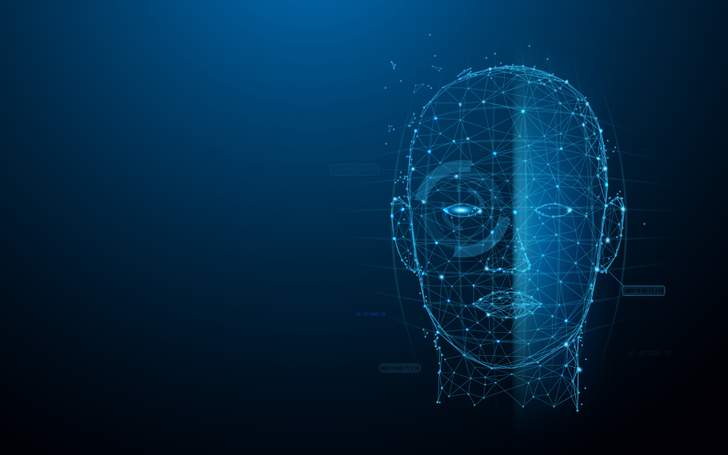
Human Face Recognition Attendance System
Group Number-65:
Group Members:
Hira khan-0537cs191033
Saad ahmed-0537cs191069
Mohd Mufeez:-0187Cs191089
Mohd Ibrahim SaleEm:-0187CS191088

Slide 2
ABSTRACT
The main purpose of this project is to build a face recognition-based attendance monitoring system for educational institution to enhance and upgrade the current attendance system into more efficient and effective as compared to before. Face detection is used to locate the position of face region and face recognition is used for marking the understudy’s attendance. The database of all the students in the class is stored and when the face of the individual student matches with one of the faces stored in the database then the attendance is recorded.

Slide 3
IntroDuction
As we are making a system which can recognize face and match with its own database. It will make the attendance system more authentic. Our primary goal is to help the lecturers, improve and organize the process of track and manage student attendance and absenteeism.

Slide 4
Aim and objectves
The objective of this project is to develop face recognition based automated student attendance system. Expected achievements in order to fulfill the objectives are:
1. To detect the face segment from the video frame.
2. To extract the useful features from the face detected.
3. To classify the features in order to recognize the face detected.
4. To record the attendance of the identified student.

Slide 5
What Is Face Detection and face recognition?
Face detection is the process of identifying and locating all the present faces in a single image or video regardless of their position, scale, orientation, age and expression.
Face Recognition is a visual pattern recognition problem, where the face, represented as a three dimensional object that is subject to varying illumination, pose and other factors, needs to be identified based on acquired images

Slide 6
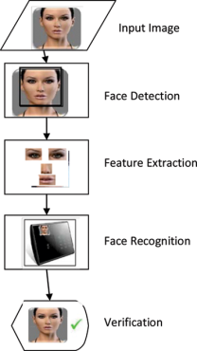
Diagrammatic representation

Slide 7
Software and hardware REQUIREMENTS
Program language: Python 3.7
Software:
1. PyCharm 2019.2
2. VS CODE
3. GIT
Hardware:
1. Processor-i3
2. Hard Disk-5GB
3. RAM-1GB
4. Webcam

Slide 8
Module used
1. OpenCV Contrib 4.0.1
2. Pillow
3. Pandas
4. CSV
5. Tkinter
6.Date Time

Slide 9
Face recognition algorithms
1. Haar-Cascade
2. LBPH (Local Binary Pattern Histogram)

Slide 10
Functional Requirements
The faces must be detected in bounding boxes.
Compute the total attendance based on detected faces
Crop the total number of faces detected.
Resize the cropped faces to match faces the size required for recognition.
Store the cropped faces to a folder.
Load faces on database.
Train faces for recognition.
Perform recognition for faces stored on database.
Compute recognition rate of the system.
Perform recognition one after the other for each face cropped by Face Detector.
Display the input image alongside output image side by side on the same plot.
Display the name of the output image above the image in the plot area..

Slide 11
Non-Functional Requirements
1. The system should perform the process accurately and precisely to avoid problems.
2. The system should be easy to modify for any updates.
3. Any errors or bugs that are identified should be easy to mend.
4. The system should be secure and maintain the privacy of the students.
5. The system should be easy to understand and use.
6. Execution of the operation should be fast.

Slide 12
How does it work?
The student interact with the system through the Graphical User Interface (GUI) above. The first step the student has to enter his details(Name and ID) this details will be stored in a csv file 'StudentDetailss.csv', the ID is Student Id on the GUI. second step, the student will click on the REGISTER button to capture his faces, here 50pictures of the student will be taken and stored in the TrainingImages Folder. The haar-cascadeclassifier file to detect faces through the video stream while the student face is being captured. The notification board will print out the student details after a successful data collection.
The student has to click on the TRAIN IMAGE button which will link his details, face features to the LBPHrecognizer to ease further face recognition, the recognizer will save the face features in the trainner.yml and "IMAGE TRAINED" will be printed on the GUI notification board after a successful linkage.

Slide 13
Continued…
The student has to click on the TAKE ATTENDANCE button to allow the face recognizer to track his face through a video stream, when the system successfully recognize the student face, his details will show and "ATTENDANCE UPDATED" will be printed out otherwise , the ID will be Unknown and "ID UNKOWN, ATTENDANCE NOT UPDATED" will be printed out. Simultaneously, a csv file AttendanceFile.csv' will be updated with the ID,NAME of the student and DATE And TIME at which his face has recognized. the Unknown face captured will be store in the UnkownImages folder.

Slide 14
Advantages
The system stores the faces that are detected and automatically marks attendance.
Ease of use.
Multiple face detection.
One of the most inexpensive biometric.

Slide 15
Disadvantages
The accuracy of the system is not 100%. It can only detect face from a limited distance.
Face detection and loading training data processes just a little bit slow.

Slide 16
Result Analysis
The result of our project is almost 75-81%. Though it is not enough for this little dataset. To make it almost 98% accurate we need to use more powerful hardware and also need more resources.

Slide 17
Conclusion
This system aims to build an effective class attendance system using face recognition techniques. The proposed system will be able to mark the attendance via face Id. It will detect faces via webcam and then recognize the faces. After recognition, it will mark the attendance of the recognized student and update the attendance record.

Slide 18
Future scope
The future scope of the proposed work can be, capturing multiple detailed images of the students and using any cloud technology to store these images. The system can be configured and used in Atm machines to detect frauds. Also, the system can be used at the time of elections where the voter can be identified by recognizing the face.

Slide 19
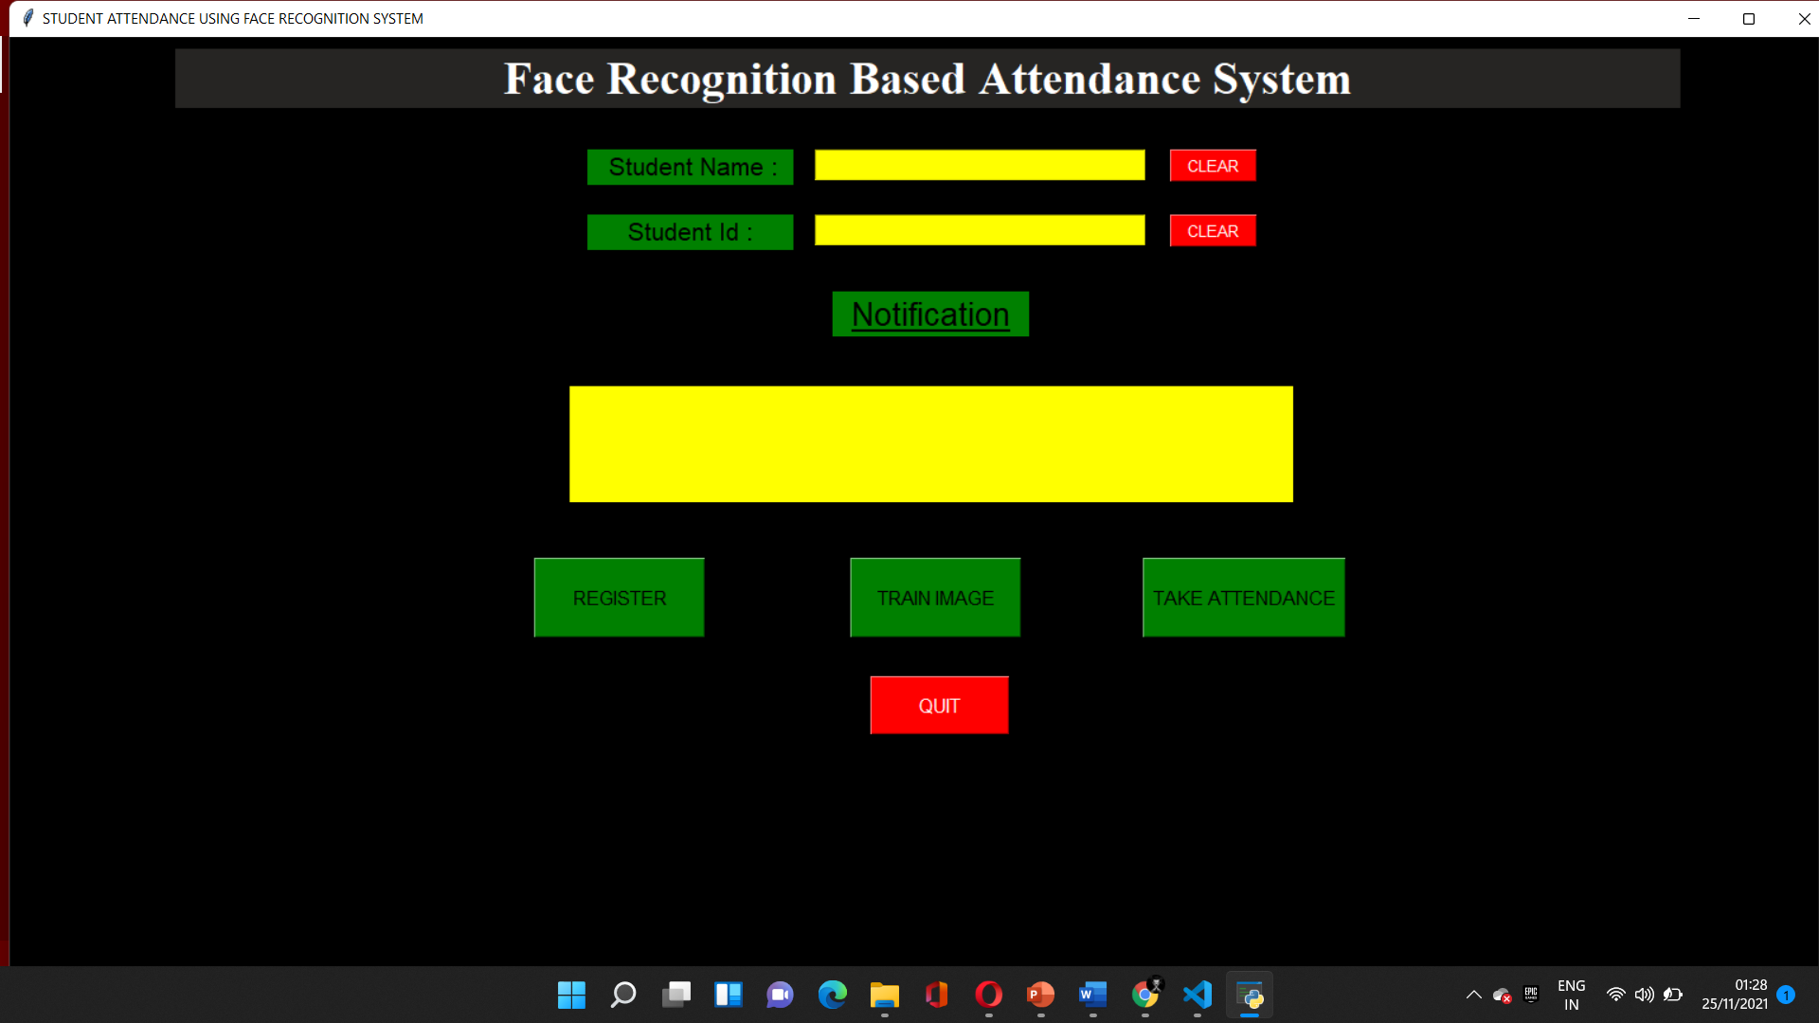
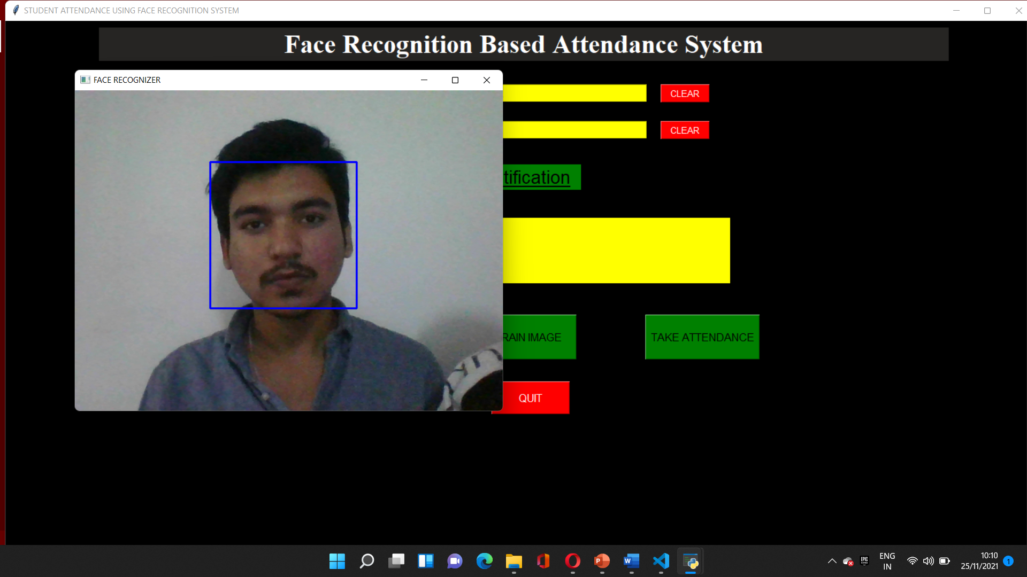
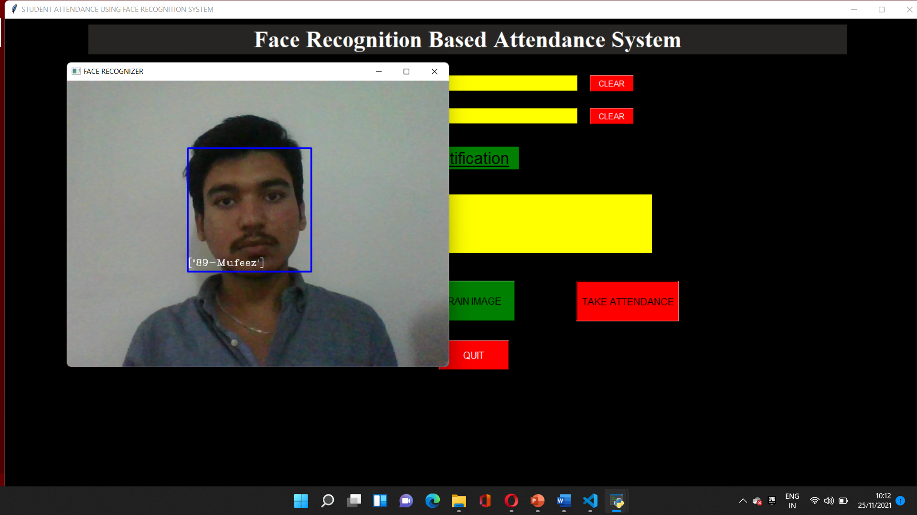
FRAS Interface and screen shots(of pages implemented)

Slide 20
THANK YOU

